Slide 1
EMTH1019 LASE – Week 2

Slide 2
Probability Distributions
Discrete & Continuous Random Variables
Mean & Variance of Random Variables
Probability Functions & Probability Density Functions

Slide 3
Key Concepts
Discrete random distributions
Continuous random distributions
Normal distributions

Slide 4
random
Adjective: proceed, made or occurring without definite aim, reason or pattern
Origin: 1275-1325 Middle English or Old French randon, derived from randir – to gallop
In Statistics we aim to understand the characteristics of a population without measuring every item.
We often study a population by taking a (hopefully) random sample.

Slide 5
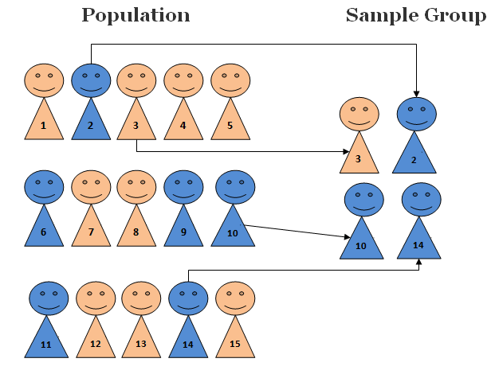
Random SAMPLING
With random sampling each member of the population has an equal chance of being chosen to be in the sample group.
Look at the image.
What are the pros and cons of using sample data versus population data?
https://www.khanacademy.org/math/math-for-fun-and-glory/math-warmup/random-sample-warmup/p/weak-law-of-large-numbers

Slide 6
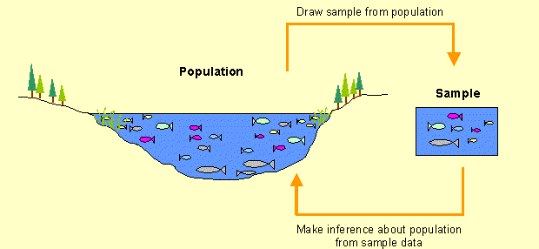
Statistical Inference
The process where we use Sample Statistics to make inferences about Populations Parameters
http://labs.geog.uvic.ca/geog226/frLab3.html

Slide 7
Random language
Random experiment
Is an experiment or a process for which the outcome cannot be predicted with certainty
Outcomes
Are the result of the experiment
Sample space
Of an experiment is the set of all possible outcomes
Element
Is what you call each outcome of a sample space

Slide 8
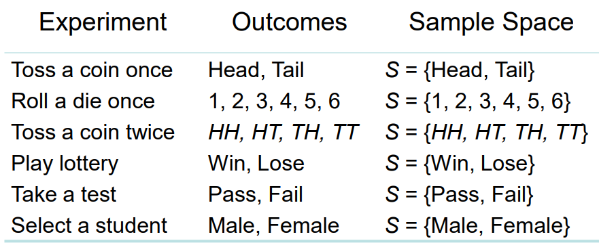
Examples
Examples

Slide 9

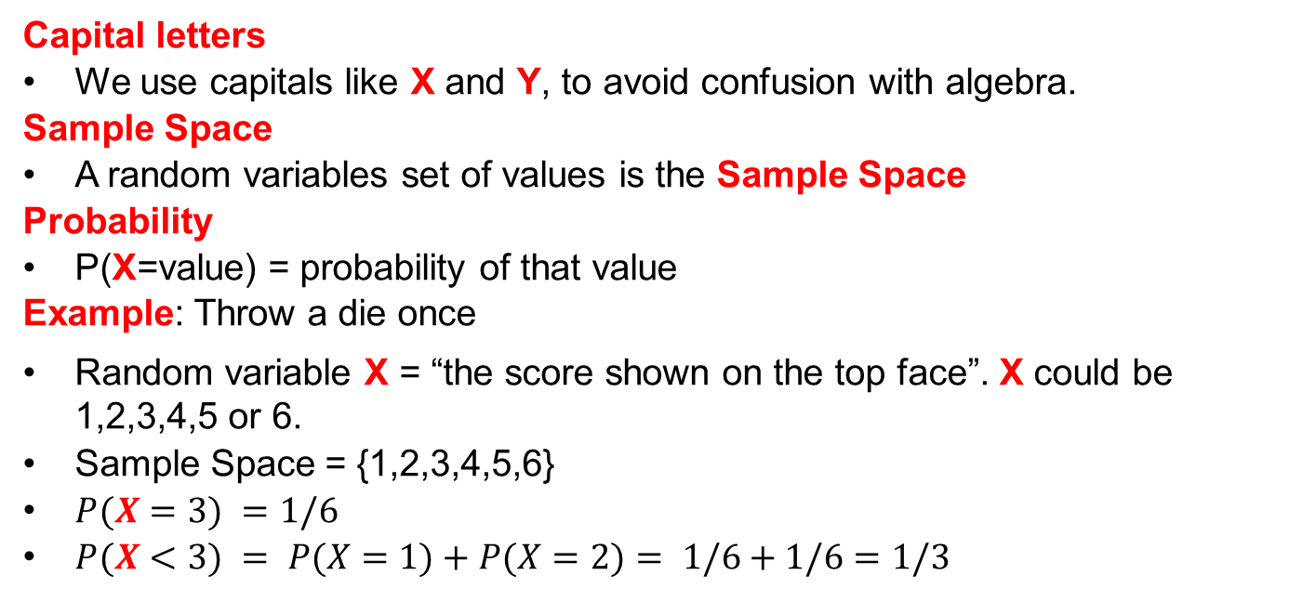
Random variable
A random variable is the set of all possible values from a random experiment
Capital letters
We use capitals like X and Y, to avoid confusion with algebra.
Sample Space
A random variables set of values is the Sample Space
Probability
P(X=value) = probability of that value
Example: Throw a die once
Random variable X = “the score shown on the top face”. X could be 1,2,3,4,5 or 6.
Sample Space = {1,2,3,4,5,6}
$P(X=3) =1/6$
$P(X<3) = P(X=1)+P(X=2)= 1/6+1/6=1/3$

Slide 10
Random variable – Maths speak
A random variable is the set of all possible values from a random experiment
If S is a sample space and X is a real valued function (a function whose values are real) defined over the elements of S, then X is called a random variable
Random variables are denoted by capital letters, X, and their values are denoted by lowercase letters, x.
x denotes a value of the random variable X
X= x is interpreted as the set of elements of the sample space for which the random variables take the value of x

Slide 11
Example 2 relays in parallel
An electrical circuit has 2 relays operating in parallel numbered 1 & 2
Current flows when a switch is thrown if either one or both relays are closed
The probability of a relay closing properly is 0.8 ( same for both relays)
The relays operate independently
Let R_{i} = the outcome that a relay closes properly: R₁ or R₂
R’_{i} that it does not close properly. R’₁ or R’₂
When a switch is thrown an event X occurs which is of interest to the operator
Draw the relay and…
List all the possibilities of the sample space S= {…..} in terms of R_{i} and R’_{i},
Calculate the probability of each possible outcome

Slide 12
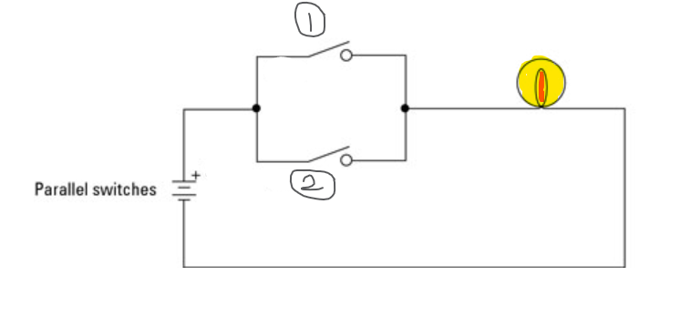
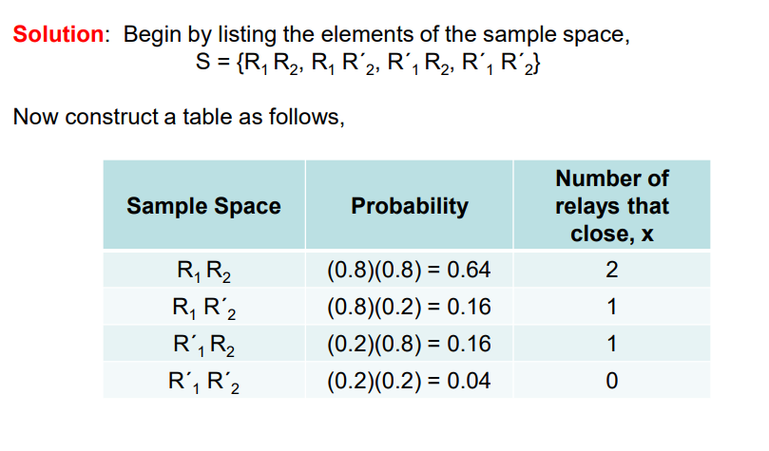
Continued…

Slide 13
Types of random variables
Discrete random variable
You can count the outcomes.
The set of possible outcomes is finite or countable
If a coin is thrown 3 times the number of heads, X, can only be 0, 1, 2, 3 so the variable is discrete
P(X=0)= 1/2*1/2*1/2=1/8 {TTT},
P(X=1)= (1/2*1/2*1/2)*3=3/8 {HTT, THT, TTH}
Continuous random variable
You can measure it with a device.
Can have infinitely many values
If we have lots of discrete data we can model it as continuous sometimes
E.g how tall you are187.23578453797 cm

Slide 14
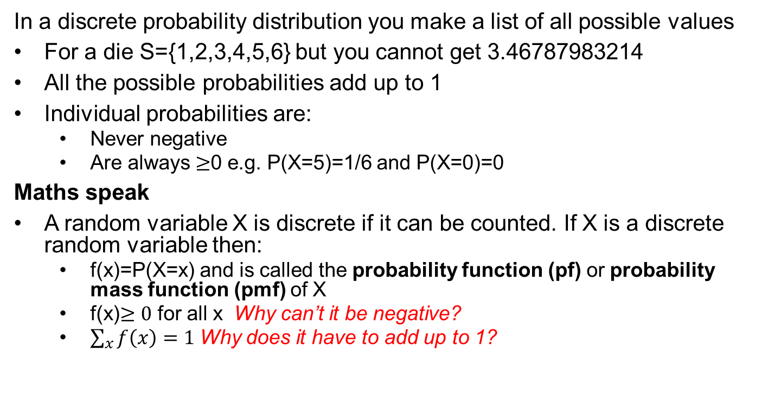
Discrete Probability distributions
In a discrete probability distribution you make a list of all possible values
For a die S={1,2,3,4,5,6} but you cannot get 3.46787983214
All the possible probabilities add up to 1
Individual probabilities are:
Never negative
Are always $≥$0 e.g. P(X=5)=1/6 and P(X=0)=0
Maths speak
A random variable X is discrete if it can be counted. If X is a discrete random variable then:
f(x)=P(X=x) and is called the probability function (pf) or probability mass function (pmf) of X
f(x)$≥0$ for all x Why can’t it be negative?
$\sum_{x}{f\left(x\right)=1}$Why does it have to add up to 1?

Slide 15
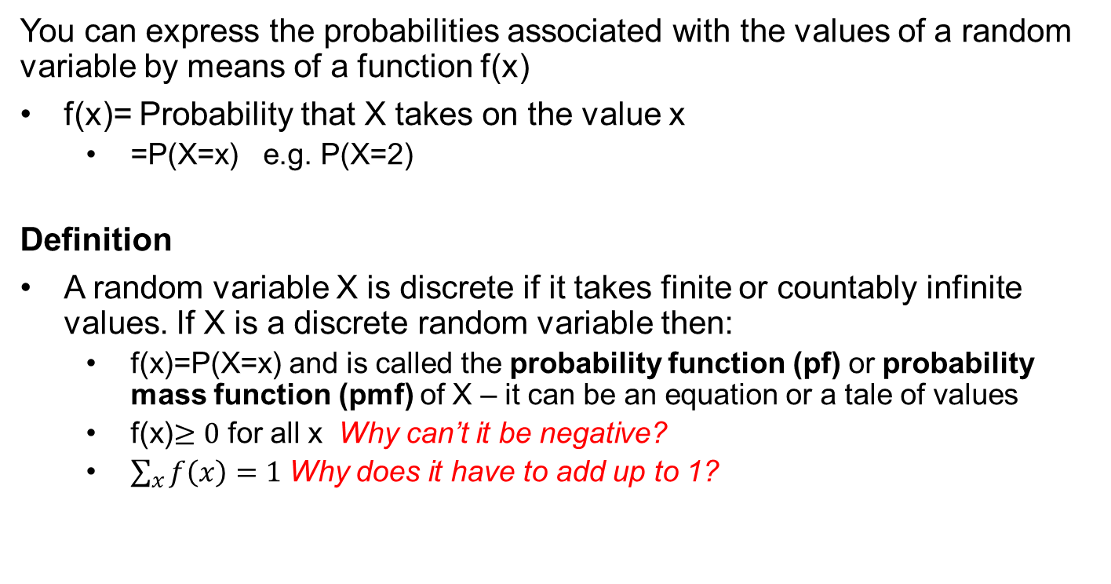
Discrete Probability distributions
You can express the probabilities associated with the values of a random variable by means of a function f(x)
f(x)= Probability that X takes on the value x
=P(X=x) e.g. P(X=2)
Definition
A random variable X is discrete if it takes finite or countably infinite values. If X is a discrete random variable then:
f(x)=P(X=x) and is called the probability function (pf) or probability mass function (pmf) of X – it can be an equation or a tale of values
f(x)$≥0$ for all x Why can’t it be negative?
$\sum_{x}{f\left(x\right)=1}$Why does it have to add up to 1?

Slide 16
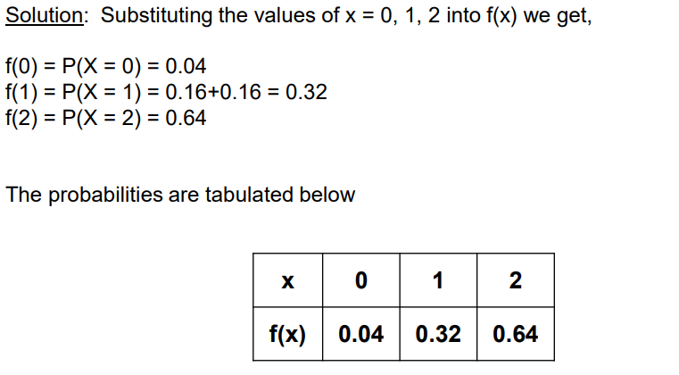
Using relay example
For the random variable X find the probability function f(x)

Slide 17
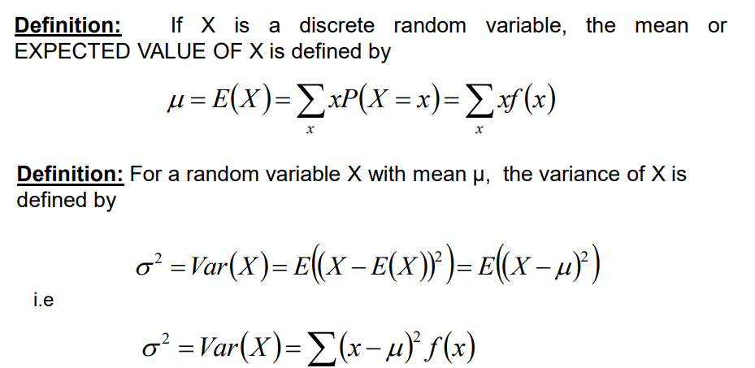
Theory: Mean (expected value) & variance

Slide 18
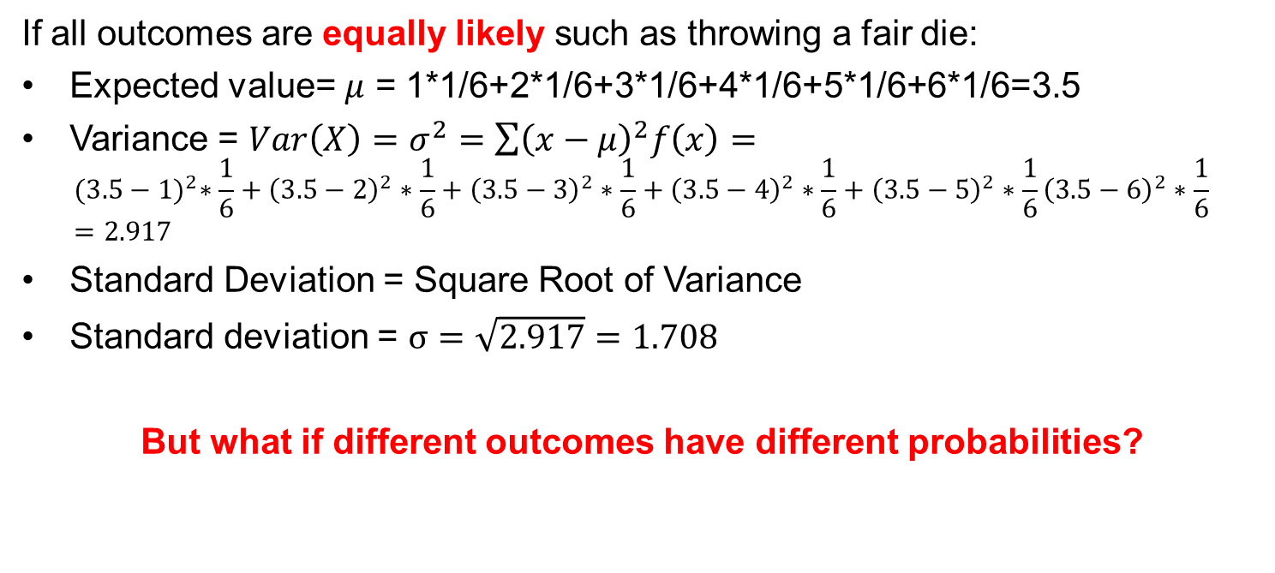
Mean (expected value) & variance
If all outcomes are equally likely such as throwing a fair die:
Expected value= $μ$ = 1*1/6+2*1/6+3*1/6+4*1/6+5*1/6+6*1/6=3.5
Variance = $Var\left(X\right)=σ^{2}=\sum{{\left(x−μ\right)}^{2}f\left(x\right)=}$ ${(3.5−1)}^{2}∗\frac{1}{6}+{\left(3.5−2\right)}^{2}∗\frac{1}{6}+{\left(3.5−3\right)}^{2}∗\frac{1}{6}+{\left(3.5−4\right)}^{2}∗\frac{1}{6}+{\left(3.5−5\right)}^{2}∗\frac{1}{6}{\left(3.5−6\right)}^{2}∗\frac{1}{6}=2.917$
Standard Deviation = Square Root of Variance
Standard deviation = $σ=\sqrt{2.917}=1.708$
But what if different outcomes have different probabilities?

Slide 19
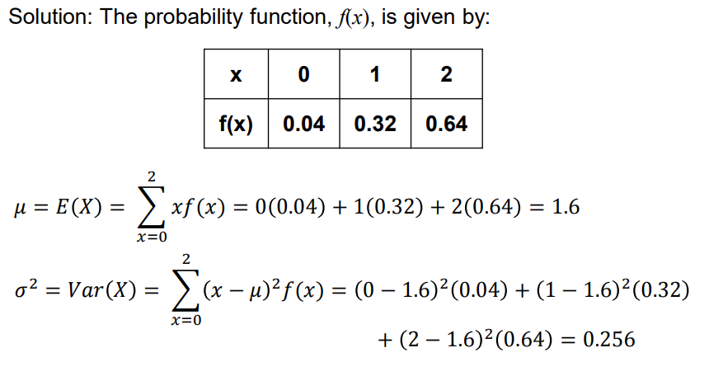
Different probabilites
Find the mean and variance of the random variable from the relay example
0.32

Slide 20
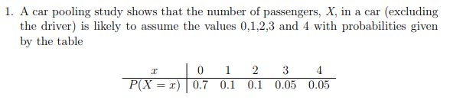

EASIER way of calculating variance
I prefer to work with $Var\left(X\right)=E\left(X^{2}\right)−{(E\left(X\right))}^{2}$
Calculate $E\left(X\right)$, $E(X^{2})$ and Variance. $Var\left(X\right)=E\left(X^{2}\right)−{(E\left(X\right))}^{2}$
Variance is always positive and $standard deviation=\sqrt{Variance}$

Slide 21
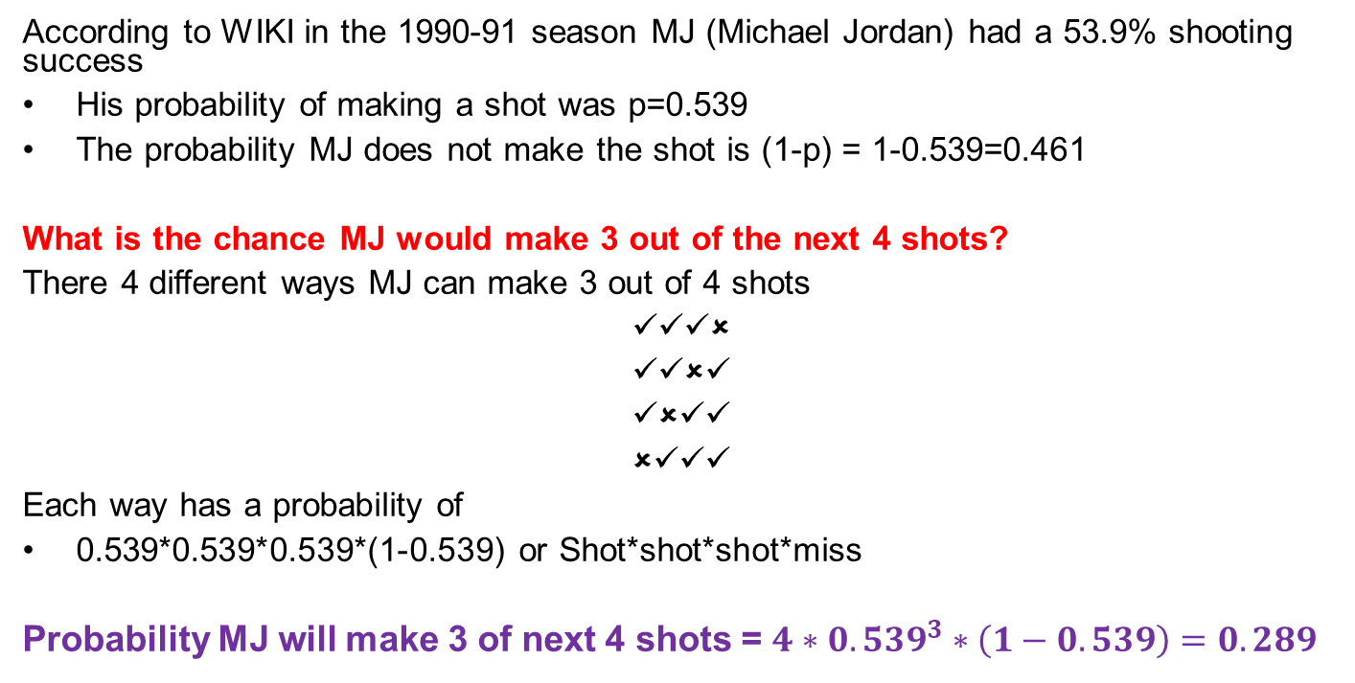
MJ and Basketball
According to WIKI in the 1990-91 season MJ (Michael Jordan) had a 53.9% shooting success
His probability of making a shot was p=0.539
The probability MJ does not make the shot is (1-p) = 1-0.539=0.461
What is the chance MJ would make 3 out of the next 4 shots?
There 4 different ways MJ can make 3 out of 4 shots
✓✓✓✗
✓✓✗✓
✓✗✓✓
✗✓✓✓
Each way has a probability of
0.539*0.539*0.539*(1-0.539) or Shot*shot*shot*miss
Probability MJ will make 3 of next 4 shots = $4∗{0.539}^{3}∗\left(1−0.539\right)=0.289$

Slide 22
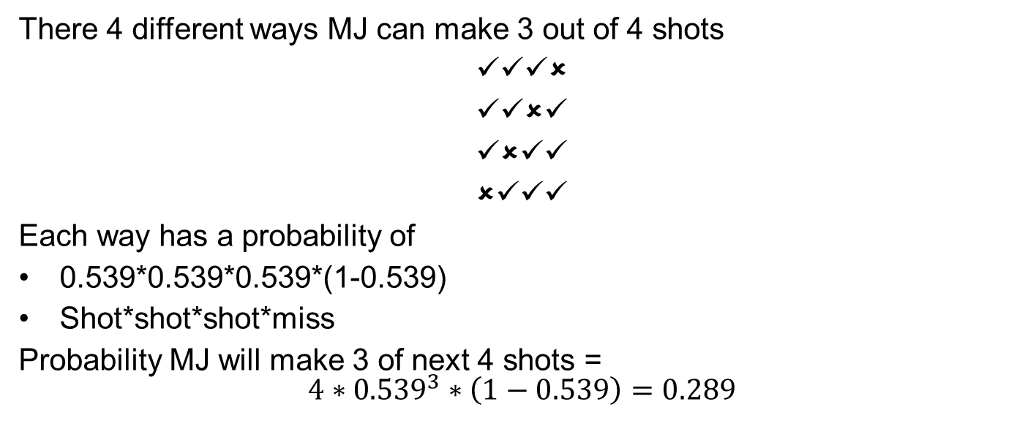
Calculation
There 4 different ways MJ can make 3 out of 4 shots
✓✓✓✗
✓✓✗✓
✓✗✓✓
✗✓✓✓
Each way has a probability of
0.539*0.539*0.539*(1-0.539)
Shot*shot*shot*miss
Probability MJ will make 3 of next 4 shots = $$4∗{0.539}^{3}∗\left(1−0.539\right)=0.289$$

Slide 23
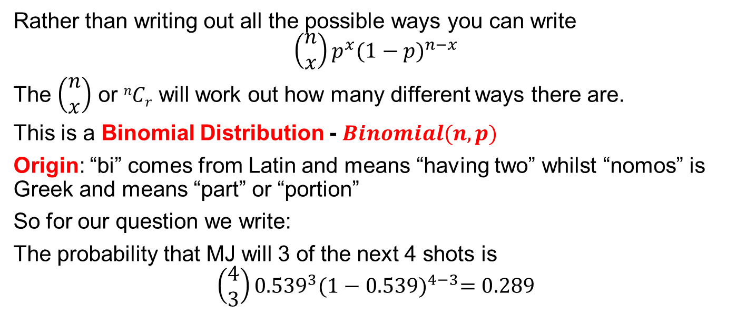
Binomial Distributions
Using Combinations to make life easier
Rather than writing out all the possible ways you can write
$$\left(\begin{matrix}n \\ x\end{matrix}\right)p^{x}{(1−p)}^{n−x}$$
The $\left(\begin{matrix}n \\ x\end{matrix}\right)$ or $nCr$ will work out how many different ways there are.
This is a Binomial Distribution - $Binomial(n,p)$
Origin: “bi” comes from Latin and means “having two” whilst “nomos” is Greek and means “part” or “portion”
So for our question we write:
The probability that MJ will 3 of the next 4 shots is
$$\left(\begin{matrix}4 \\ 3\end{matrix}\right){0.539}^{3}{(1−0.539)}^{4−3}=0.289$$

Slide 24

Determine the probabilities that MJ makes 0, 1, 2, 3 or 4 of the next 4 shots.
$$P\left(X=x\right)=\left(\begin{matrix}n \\ x\end{matrix}\right)p^{x}{(1−p)}^{n−x}$$
$$P\left(X=0\right)=\left(\begin{matrix}4 \\ 0\end{matrix}\right){0.539}^{0}{(1−0.539)}^{4−0}= \\ P\left(X=1\right)=\left(\begin{matrix}4 \\ 1\end{matrix}\right){0.539}^{1}{(1−0.539)}^{4−1}=$$

Slide 25
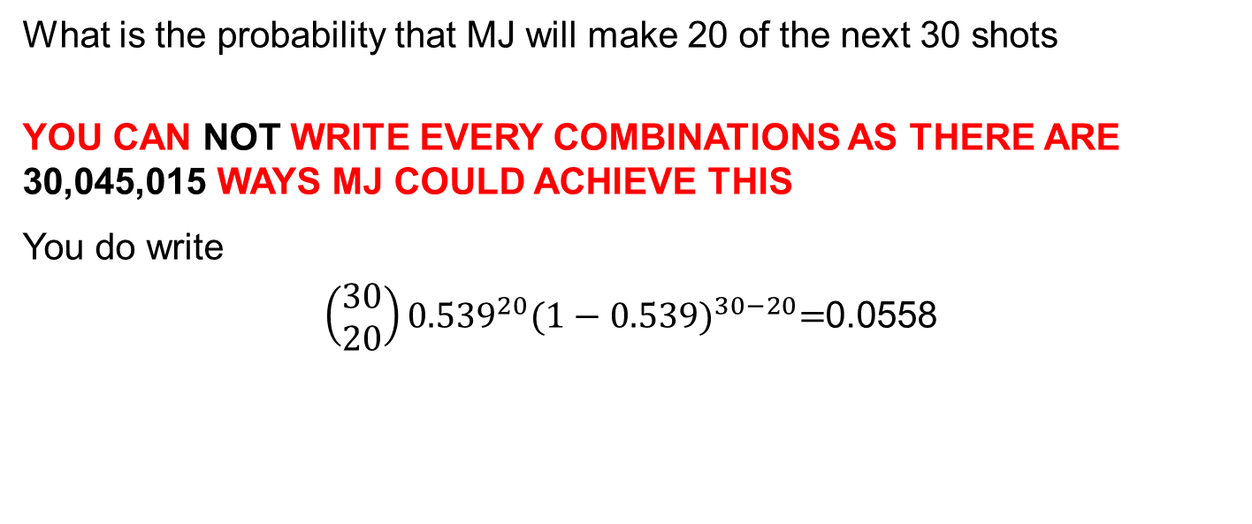
A biGger problem
If I now ask….
What is the probability that MJ will make 20 of the next 30 shots
YOU CAN NOT WRITE EVERY COMBINATIONS AS THERE ARE 30,045,015 WAYS MJ COULD ACHIEVE THIS
You do write
$\left(\begin{matrix}30 \\ 20\end{matrix}\right){0.539}^{20}{(1−0.539)}^{30−20}=$0.0558

Slide 26
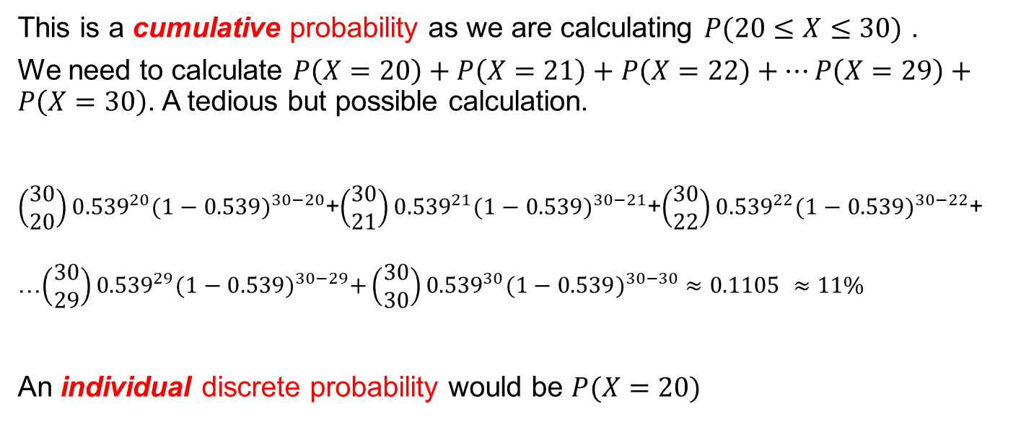
Individual versus CUMULATIVE probability
MJ makes at least 20 of the next 30 shots
This is a cumulative probability as we are calculating $P(20≤X≤30)$ .
We need to calculate $P\left(X=20\right)+P\left(X=21\right)+P\left(X=22\right)+…P\left(X=29\right)+P\left(X=30\right)$. A tedious but possible calculation.
$\left(\begin{matrix}30 \\ 20\end{matrix}\right){0.539}^{20}{(1−0.539)}^{30−20}$+$\left(\begin{matrix}30 \\ 21\end{matrix}\right){0.539}^{21}{(1−0.539)}^{30−21}$+$\left(\begin{matrix}30 \\ 22\end{matrix}\right){0.539}^{22}{(1−0.539)}^{30−22}$+
…$\left(\begin{matrix}30 \\ 29\end{matrix}\right){0.539}^{29}{(1−0.539)}^{30−29}+\left(\begin{matrix}30 \\ 30\end{matrix}\right){0.539}^{30}{(1−0.539)}^{30−30} ≈0.1105 ≈11\%$
An individual discrete probability would be $P(X=20)$

Slide 27
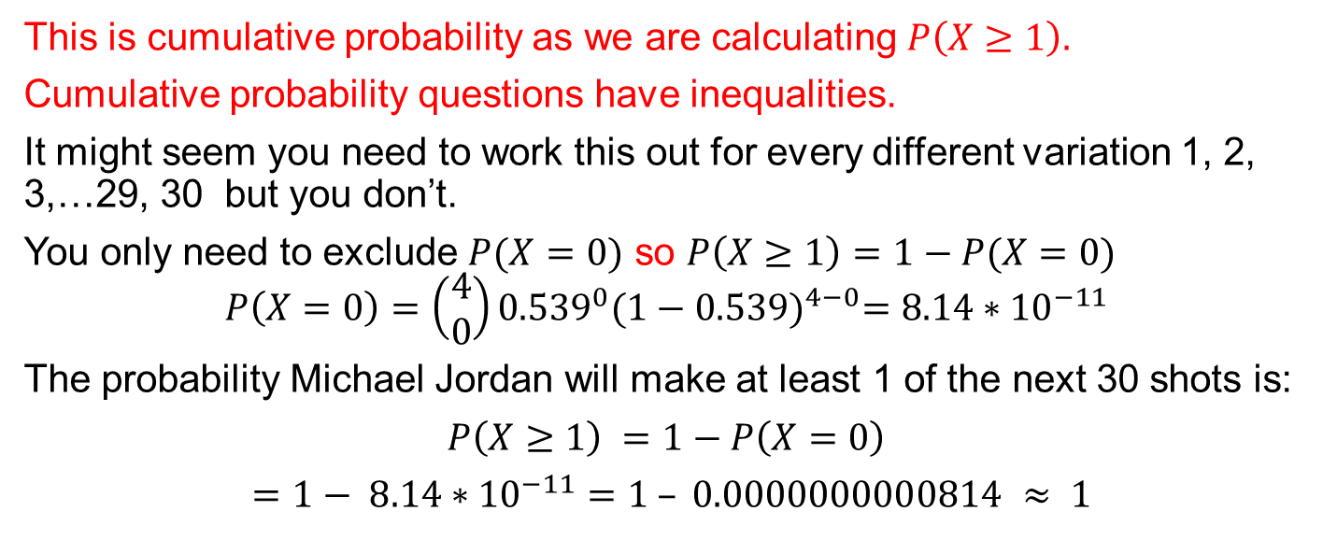
Cumulative probability
MJ made at least 1 of the next 30 shots
This is cumulative probability as we are calculating $P\left(X≥1\right).$
Cumulative probability questions have inequalities.
It might seem you need to work this out for every different variation 1, 2, 3,…29, 30 but you don’t.
You only need to exclude $P(X=0)$ so $P\left(X≥1\right)=1−P(X=0)$
$$P\left(X=0\right)=\left(\begin{matrix}4 \\ 0\end{matrix}\right){0.539}^{0}{(1−0.539)}^{4−0}=8.14∗{10}^{−11}$$
The probability Michael Jordan will make at least 1 of the next 30 shots is:
$P\left(X≥1\right)$ $=1−P\left(X=0\right)$
$=1− 8.14∗{10}^{−11}=1 – 0.0000000000814 ≈ 1$

Slide 28
Bernoulli and Binomial
People get these words mixed up.
In the Michael Jordan question the probability of MJ making a shot is the Bernoulli variable. p=0.539.
The Binomial part uses that initial probability to work out the probability of making 3 of the next 30 shots or at least 1 of the next 30 shots.
The next few slides present some of the theory behind this and as always some of the jargon.

Slide 29
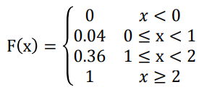

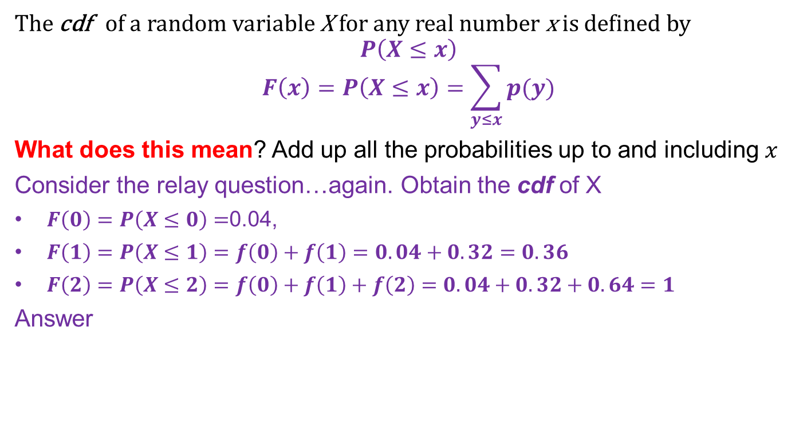
Cumulative Distribution Function (cdf) of X
Often we want to know $P(3≤X≤5)$ or $P(X≤4)$ or $P(X<7)$
The cdf of a random variable X for any real number x is defined by
$$P\left(X≤x\right)$$
$$F\left(x\right)=P\left(X≤x\right)=\sum_{y≤x}{p(y)}$$
What does this mean? Add up all the probabilities up to and including $x$
Consider the relay question…again. Obtain the cdf of X
$F\left(0\right)=P\left(X≤0\right)=$0.04,
$F\left(1\right)=P\left(X≤1\right)=f\left(0\right)+f\left(1\right)=0.04+0.32=0.36$
$F\left(2\right)=P\left(X≤2\right)=f\left(0\right)+f\left(1\right)+f\left(2\right)=0.04+0.32+0.64=1$
Answer
$$≤$$

Slide 30

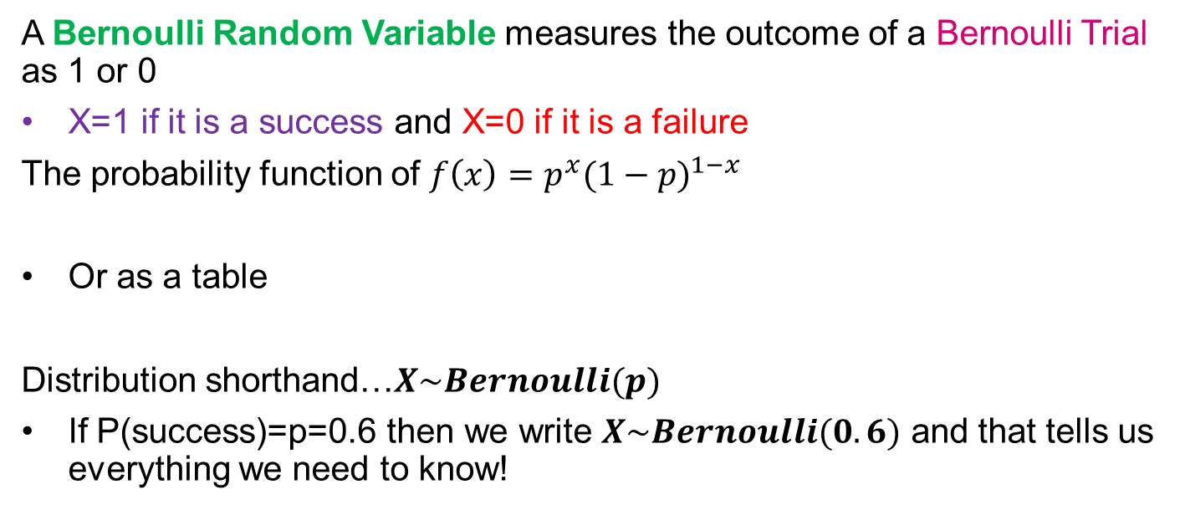
Bernoulli Distributions
A Bernoulli Trial is an experiment in which there are only 2 possible outcomes, success or failure. If P(success)=p, then P(failure)=1-p
A Bernoulli Random Variable measures the outcome of a Bernoulli Trial as 1 or 0
X=1 if it is a success and X=0 if it is a failure
The probability function of $f\left(x\right)=p^{x}{(1−p)}^{1−x}$
Or as a table
Distribution shorthand…$X\sim Bernoulli(p)$
If P(success)=p=0.6 then we write $X\sim Bernoulli(0.6)$ and that tells us everything we need to know!

Slide 31


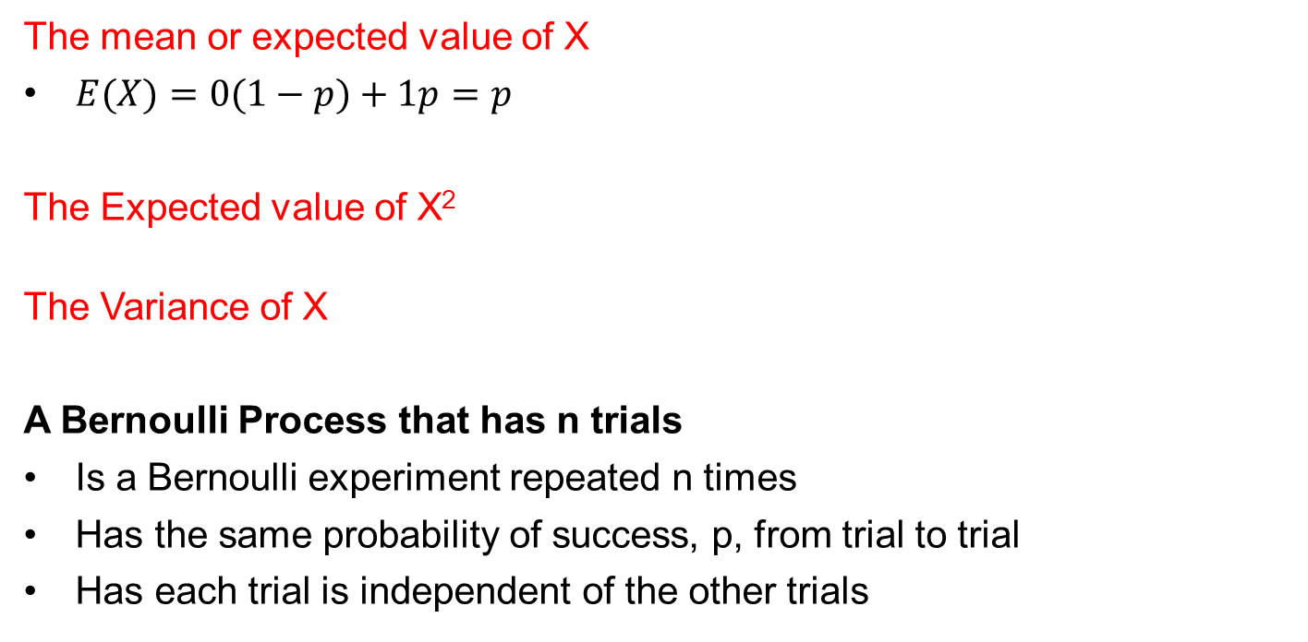
Mean & variance of the Bernoulli random variable x
The mean or expected value of X
$E(X)=0(1−p)+1p=p$
The Expected value of X²
The Variance of X
A Bernoulli Process that has n trials
Is a Bernoulli experiment repeated n times
Has the same probability of success, p, from trial to trial
Has each trial is independent of the other trials

Slide 32
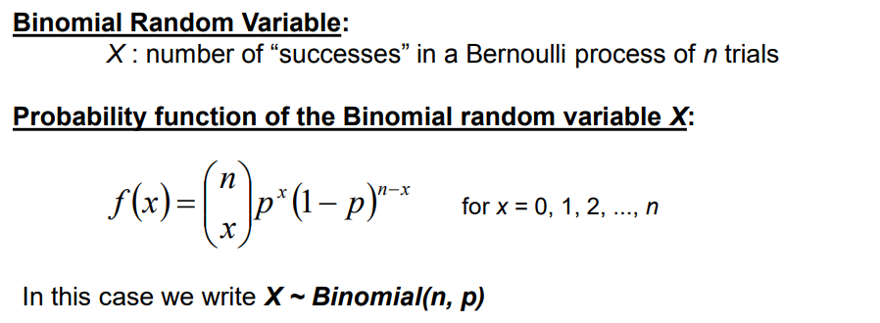
Binomial random variable
When there are n trials….
The values for pf and for cdf ( cumulative) are listed in statistical tables

Slide 33

Notation – we use Combinations
Permutations
^{n}P_{r}=$\frac{n!}{\left(n−r\right)!}=P(n,r)$
Combinations
^{n}C_{r}=$\frac{n!}{r!\left(n−r\right)!}=C\left(n,r\right)= \left(\begin{matrix}n \\ r\end{matrix}\right)$

Slide 34
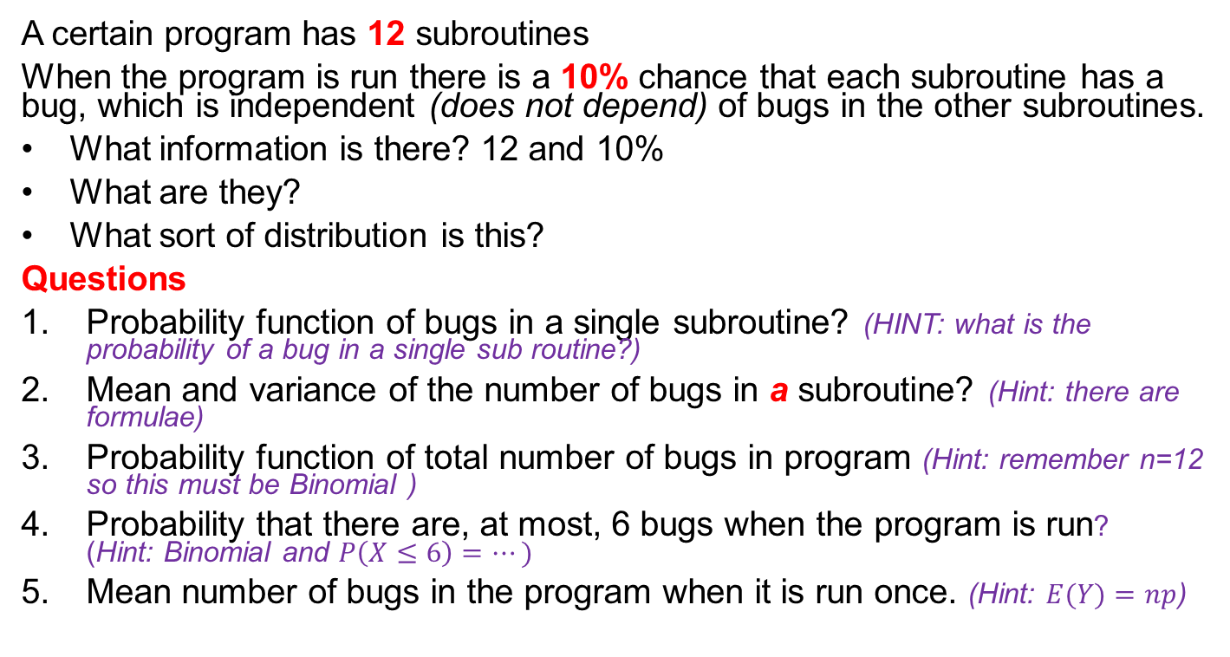
bugs
A certain program has 12 subroutines
When the program is run there is a 10% chance that each subroutine has a bug, which is independent (does not depend) of bugs in the other subroutines.
What information is there? 12 and 10%
What are they?
What sort of distribution is this?
Questions
Probability function of bugs in a single subroutine? (HINT: what is the probability of a bug in a single sub routine?)
Mean and variance of the number of bugs in a subroutine? (Hint: there are formulae)
Probability function of total number of bugs in program (Hint: remember n=12 so this must be Binomial )
Probability that there are, at most, 6 bugs when the program is run? (Hint: Binomial and $P\left(X≤6\right)=…)$
Mean number of bugs in the program when it is run once. (Hint: $E(Y)=np$)

Slide 35
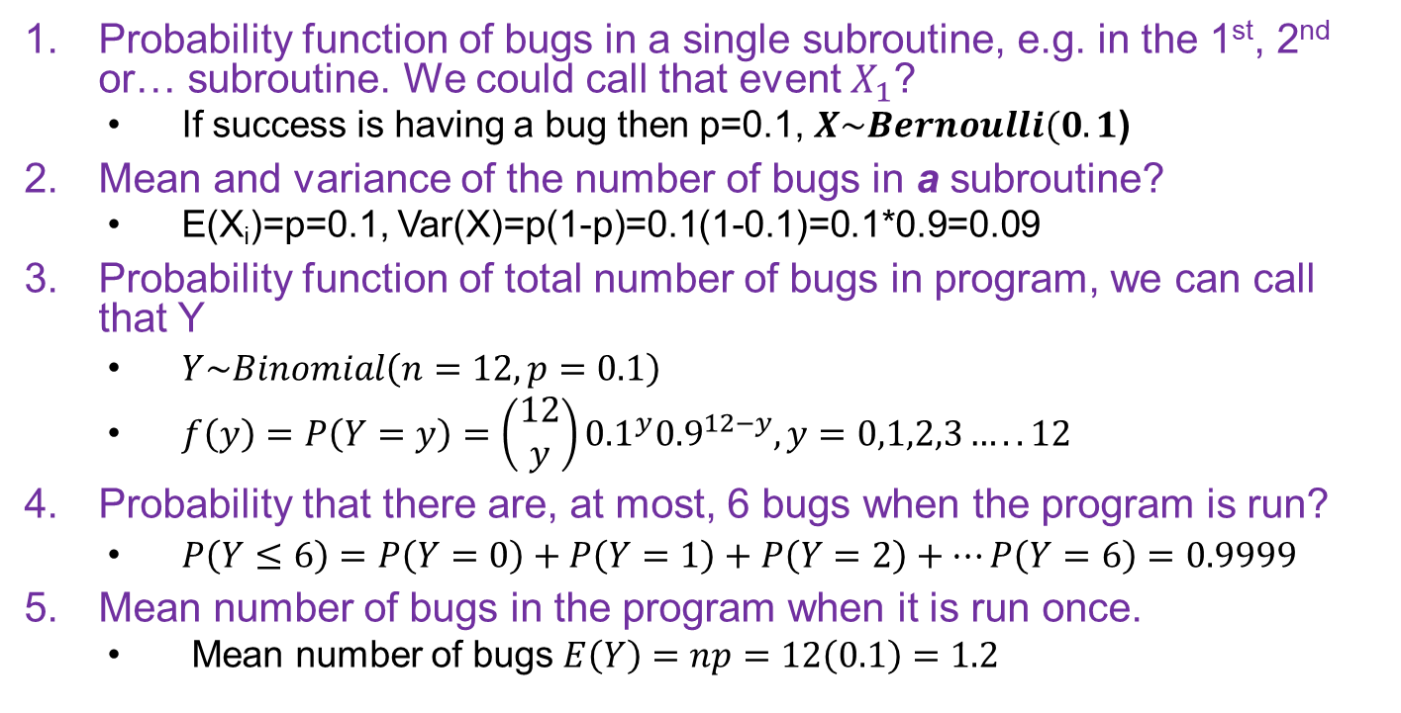
Solution
Probability function of bugs in a single subroutine, e.g. in the 1st, 2nd or… subroutine. We could call that event $X_{1}$?
If success is having a bug then p=0.1, $X\sim Bernoulli(0.1$)
Mean and variance of the number of bugs in a subroutine?
E(X_{i})=p=0.1, Var(X)=p(1-p)=0.1(1-0.1)=0.1*0.9=0.09
Probability function of total number of bugs in program, we can call that Y
$Y\sim Binomial\left(n=12,p=0.1\right)$
$f\left(y\right)=P\left(Y=y\right)=\left(\begin{matrix}12 \\ y\end{matrix}\right){0.1}^{y}{0.9}^{12−y}, y=0,1,2,3…..12$
Probability that there are, at most, 6 bugs when the program is run?
$P\left(Y≤6\right)=P\left(Y=0\right)+P\left(Y=1\right)+P\left(Y=2\right)+…P\left(Y=6\right)=0.9999$
Mean number of bugs in the program when it is run once.
Mean number of bugs $E\left(Y\right)=np=12\left(0.1\right)=1.2$

Slide 36
Example COIN tossed 10 times
A fair coin is tossed 10 times.
LET X denote the number of heads obtained.
Determine the following:
P(X<3)
P(X≥3)
P(3<X<8)
Important: if X<3 it does not include 3. You have to pay attention to the inequalities.

Slide 37
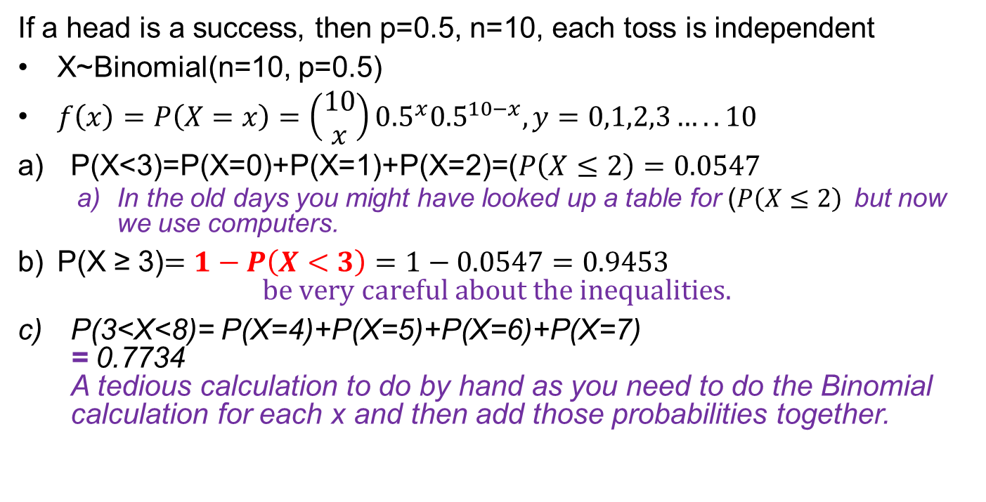
Solution
If a head is a success, then p=0.5, n=10, each toss is independent
X~Binomial(n=10, p=0.5)
$f\left(x\right)=P\left(X=x\right)=\left(\begin{matrix}10 \\ x\end{matrix}\right){0.5}^{x}{0.5}^{10−x}, y=0,1,2,3…..10$
P(X<3)=P(X=0)+P(X=1)+P(X=2)=($P\left(X≤2\right)=0.0547$
In the old days you might have looked up a table for ($P\left(X≤2\right)$but now we use computers.
P(X ≥ 3)$=1−P\left(X<3\right)=1−0.0547=0.9453$ $be very careful about the inequalities.$
P(3<X<8)= P(X=4)+P(X=5)+P(X=6)+P(X=7) = 0.7734 A tedious calculation to do by hand as you need to do the Binomial calculation for each x and then add those probabilities together.

Slide 38
prussian officers killed by horsekick
In the 19th century the Prussian military became concerned about the number of its cavalry officers killed by horse kick during peacetime.
The Prussians had the foresight to collect hard data over 20 years on death by horse kick.
It would have been easy to blame these deaths on what are described as “never events”, which are adverse, serious and largely preventable events e.g. blaming the victims for being careless, horses for being vicious or poor leadership and systems.
Instead, the Mathematician Ladislaus Bortkiewicz analyzed the data. In his book “The Law of Small Numbers” (1908) he showed that these fatalities were rare events (low frequency) in a large population and closely followed a Poisson distribution.

Slide 39
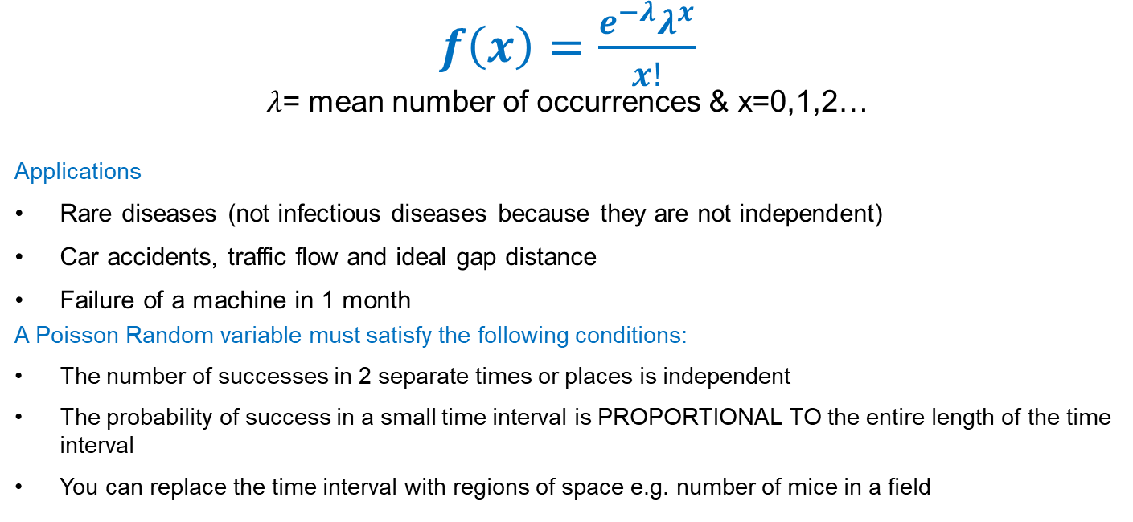
Poisson Distribution
Named after Simeon Denis Poisson in 1837. It is a discrete probability distribution that gives the probability of a given number of events occurring in a fixed interval
$f\left(x\right)=\frac{e^{−λ}λ^{x}}{x!}$
$λ$= mean number of occurrences & x=0,1,2…
Applications
Rare diseases (not infectious diseases because they are not independent)
Car accidents, traffic flow and ideal gap distance
Failure of a machine in 1 month
A Poisson Random variable must satisfy the following conditions:
The number of successes in 2 separate times or places is independent
The probability of success in a small time interval is PROPORTIONAL TO the entire length of the time interval
You can replace the time interval with regions of space e.g. number of mice in a field

Slide 40
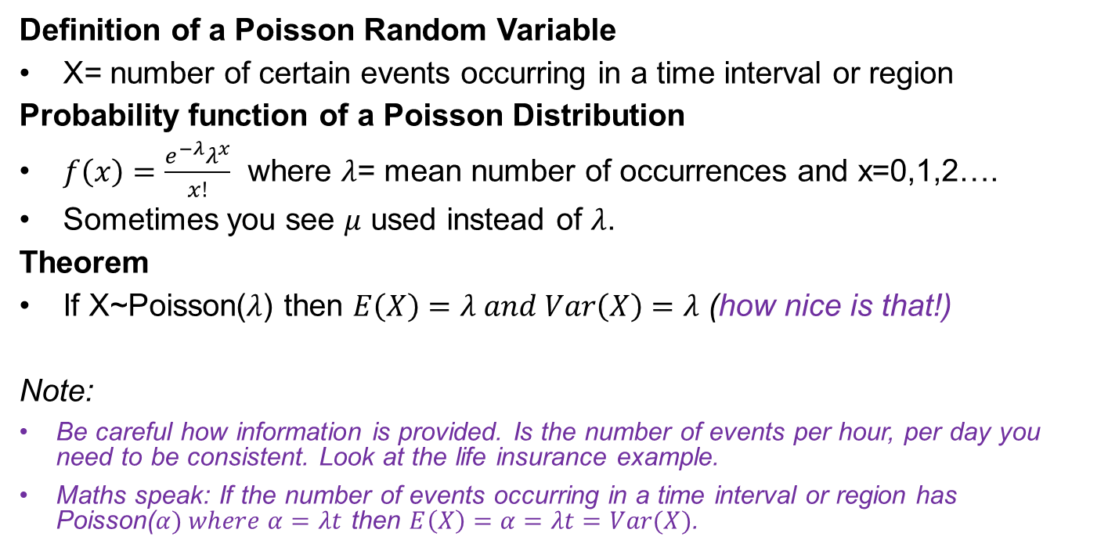
X~Poisson($λ$)
Definition of a Poisson Random Variable
X= number of certain events occurring in a time interval or region
Probability function of a Poisson Distribution
$f\left(x\right)=\frac{e^{−λ}λ^{x}}{x!}$ where $λ$= mean number of occurrences and x=0,1,2….
Sometimes you see $μ$ used instead of $λ$.
Theorem
If X~Poisson($λ$) then $E\left(X\right)=λ and Var\left(X\right)=λ$ (how nice is that!)
Note:
Be careful how information is provided. Is the number of events per hour, per day you need to be consistent. Look at the life insurance example.
Maths speak: If the number of events occurring in a time interval or region has Poisson($α) where α=λt$ then $E\left(X\right)=α=λt=Var(X)$.

Slide 41
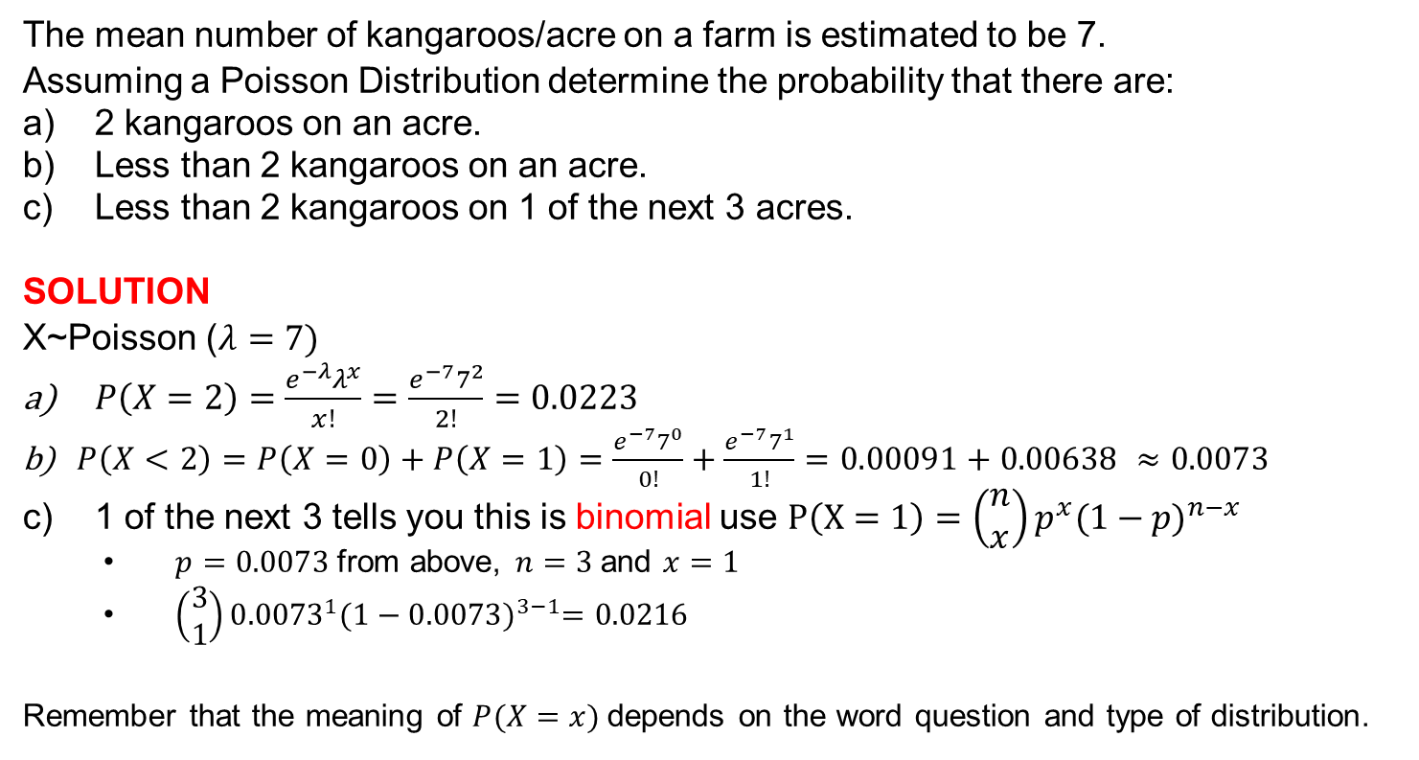
Classic poisson question
The mean number of kangaroos/acre on a farm is estimated to be 7.
Assuming a Poisson Distribution determine the probability that there are:
2 kangaroos on an acre.
Less than 2 kangaroos on an acre.
Less than 2 kangaroos on 1 of the next 3 acres.
SOLUTION
X~Poisson ($λ=7)$
$P\left(X=2\right)=\frac{e^{−λ}λ^{x}}{x!}=\frac{e^{−7}7^{2}}{2!}=0.0223$
$P\left(X<2\right)=P\left(X=0\right)+P\left(X=1\right)=\frac{e^{−7}7^{0}}{0!}+\frac{e^{−7}7^{1}}{1!}=0.00091+0.00638 ≈0.0073$
1 of the next 3 tells you this is binomial use $P\left(X=1\right)=\left(\begin{matrix}n \\ x\end{matrix}\right)p^{x}{(1−p)}^{n−x}$
$p=0.0073$from above, $n=3$and $x=1$
$\left(\begin{matrix}3 \\ 1\end{matrix}\right){0.0073}^{1}{(1−0.0073)}^{3−1}=0.0216$
Remember that the meaning of $P(X=x)$depends on the word question and type of distribution.

Slide 42
Poisson and Life Insurance
A life insurance salesman sells on average 3 policies per week.
Assuming a Poisson Distribution calculate the probability that in a week he will sell:
Some policies
2 or more policies but less than 5
Assuming there are 5 working days in a week what is the probability that on a given day he will sell one policy?
https://www.intmath.com/counting-probability/13-poisson-probability-distribution.php

Slide 43
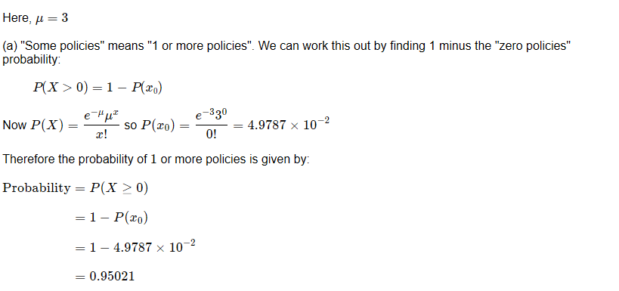
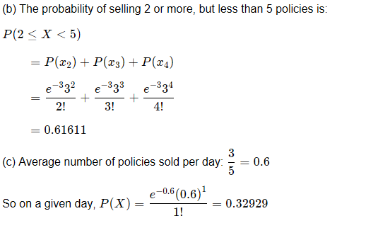

Slide 44
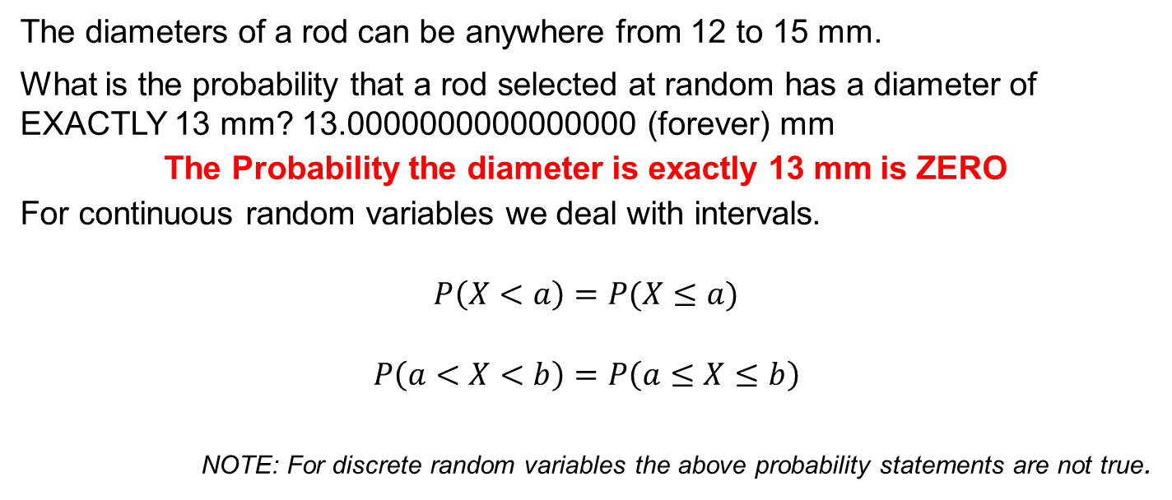
Continuous probability distributions
A random variable X is continuous if P(X=x)=0 for all real numbers x
The diameters of a rod can be anywhere from 12 to 15 mm.
What is the probability that a rod selected at random has a diameter of EXACTLY 13 mm? 13.0000000000000000 (forever) mm
The Probability the diameter is exactly 13 mm is ZERO
For continuous random variables we deal with intervals.
$$P\left(X<a\right)=P(X≤a)$$
$$P\left(a<X<b\right)=P\left(a≤X≤b\right)$$
NOTE: For discrete random variables the above probability statements are not true.

Slide 45
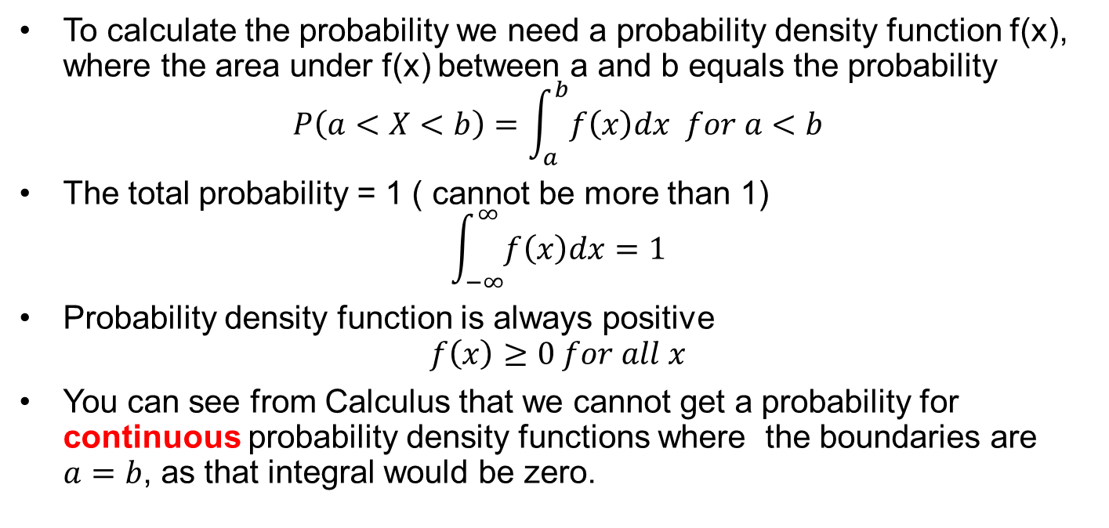
Some theory
To calculate the probability we need a probability density function f(x), where the area under f(x) between a and b equals the probability
$$P\left(a<X<b\right)=\int_{a}^{b}{f\left(x\right)dx for a<b}$$
The total probability = 1 ( cannot be more than 1)
$$\int_{−∞}^{∞}{f\left(x\right)dx=1}$$
Probability density function is always positive
$$f\left(x\right)≥0 for all x$$
You can see from Calculus that we cannot get a probability for continuous probability density functions where the boundaries are $a=b$, as that integral would be zero.

Slide 46
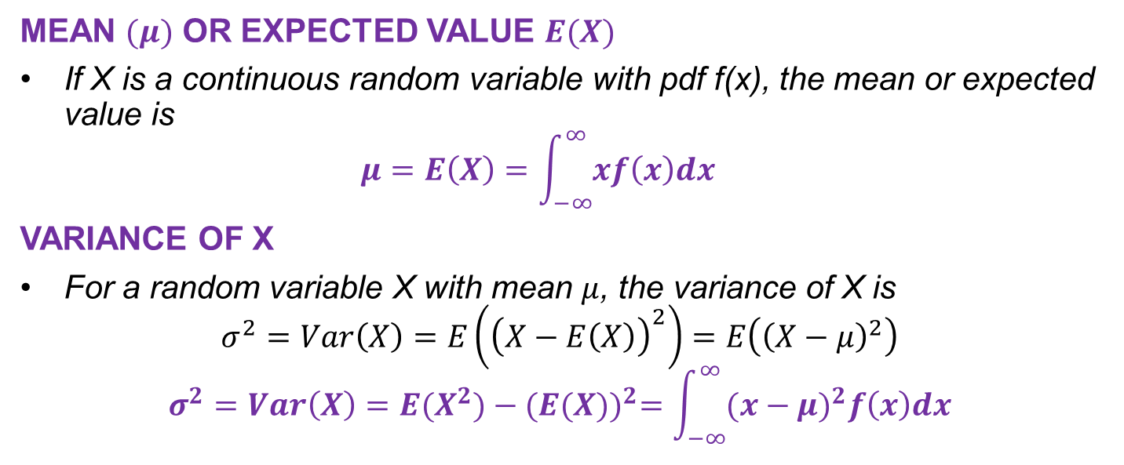
Theory - Mean & variance
MEAN $(μ)$ OR EXPECTED VALUE $E(X)$
If X is a continuous random variable with pdf f(x), the mean or expected value is $μ=E\left(X\right)=\int_{−∞}^{∞}{xf\left(x\right)dx}$
VARIANCE OF X
For a random variable X with mean $μ$, the variance of X is $σ^{2}=Var\left(X\right)=E\left({\left(X−E\left(X\right)\right)}^{2}\right)=E\left({\left(X−μ\right)}^{2}\right)$
$$σ^{2}=Var\left(X\right)=E(X^{2})−{(E(X))}^{2}=\int_{−∞}^{∞}{{(x−μ)}^{2}f\left(x\right)dx}$$

Slide 47
Do not panic
We do not do any calculus in this unit so you do not have to be able to calculate these integrals.
We will be using normal distribution tables.

Slide 48
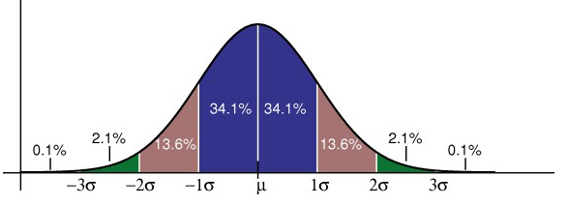
Normal distributions $X\sim N(μ, σ^{2})$
http://www.statisticshowto.com/probability-and-statistics/normal-distributions/

Slide 49
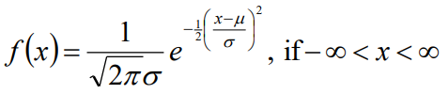
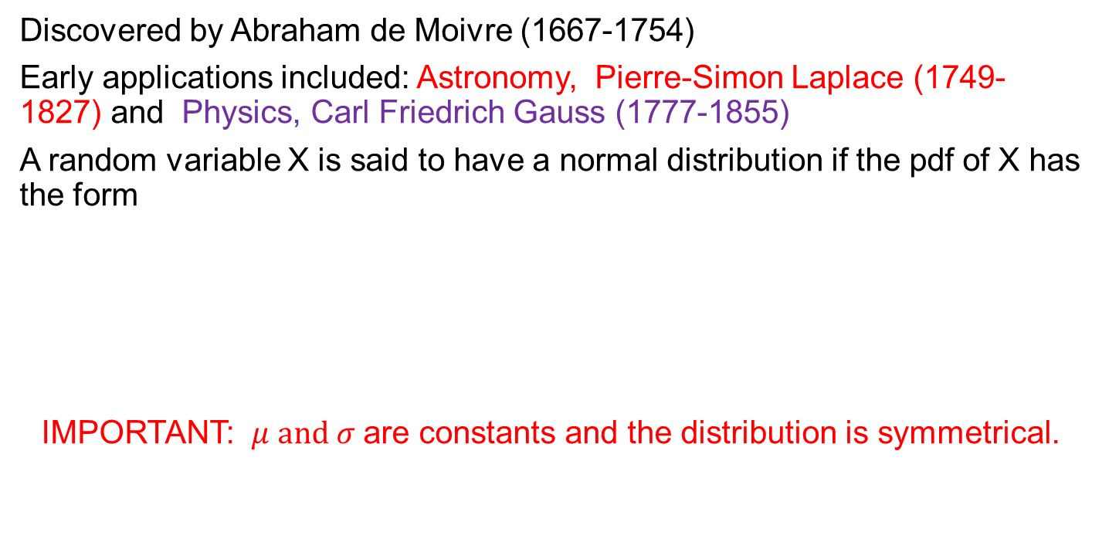
A little normal history
Discovered by Abraham de Moivre (1667-1754)
Early applications included: Astronomy, Pierre-Simon Laplace (1749-1827) and Physics, Carl Friedrich Gauss (1777-1855)
A random variable X is said to have a normal distribution if the pdf of X has the form
IMPORTANT: $μ and σ$ are constants and the distribution is symmetrical.

Slide 50

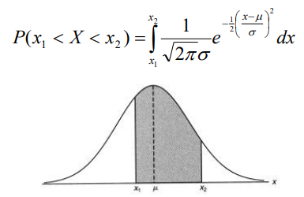
normal distribution theory
The pdf of a normal distribution is a difficult function to deal with.
And then to calculate the probability, then is an even uglier integral to solve.

Slide 51
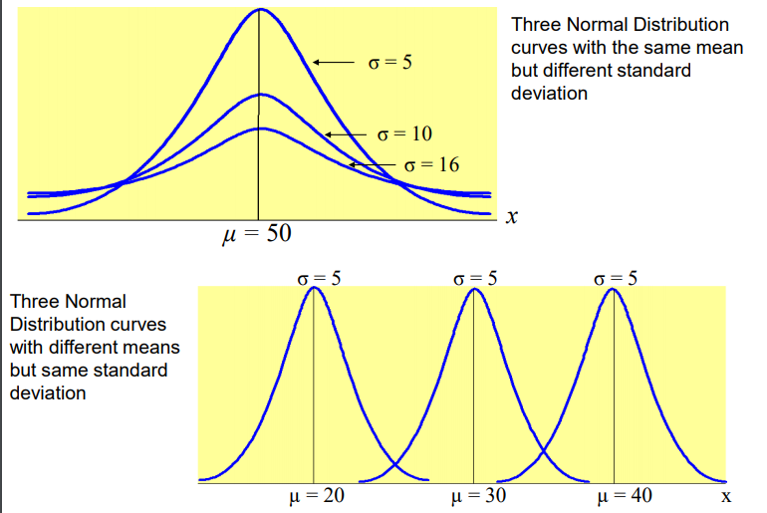
Normal distributions

Slide 52
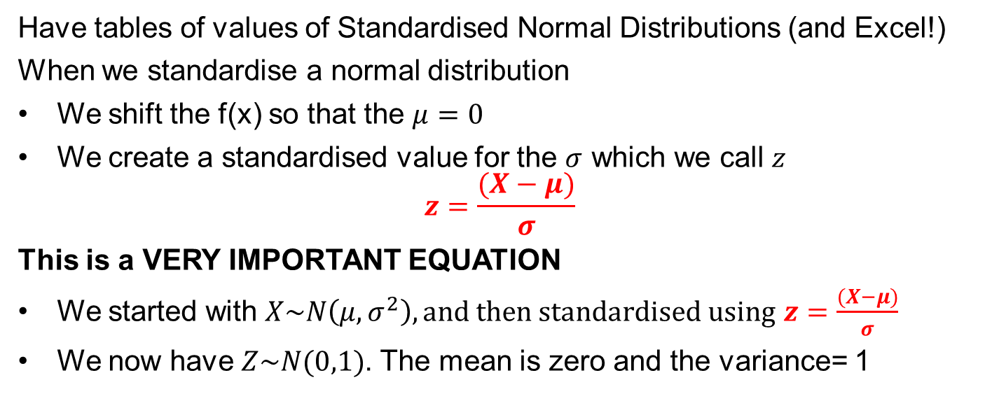
Standard normal distributions
To get arounds the difficulties of dealing with the equations…
Have tables of values of Standardised Normal Distributions (and Excel!)
When we standardise a normal distribution
We shift the f(x) so that the $μ=0$
We create a standardised value for the $σ$ which we call $z$
$$z=\frac{(X−μ)}{σ}$$
This is a VERY IMPORTANT EQUATION
We started with $X\sim N\left(μ,σ^{2}\right), and then standardised using$ $z=\frac{(X−μ)}{σ}$
We now have $Z\sim N(0,1)$. The mean is zero and the variance= 1

Slide 53
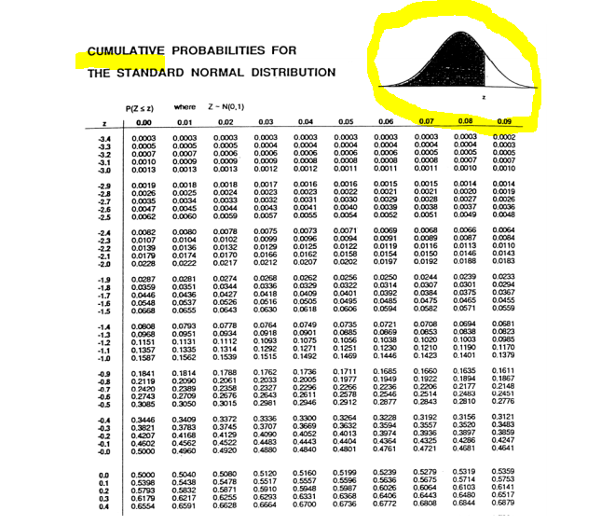

Slide 54

Using Cumulative normal distribution tables
Supose Z has standard normal distribution.
What is the value of $μ$ $and σ$?
P(Z<1.9)
P(Z>1.9)
P(-1<Z<1)
P(-2.1<Z<4.2)

Slide 55
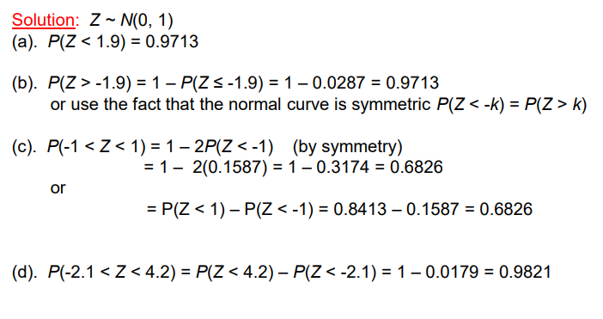
solution

Slide 56
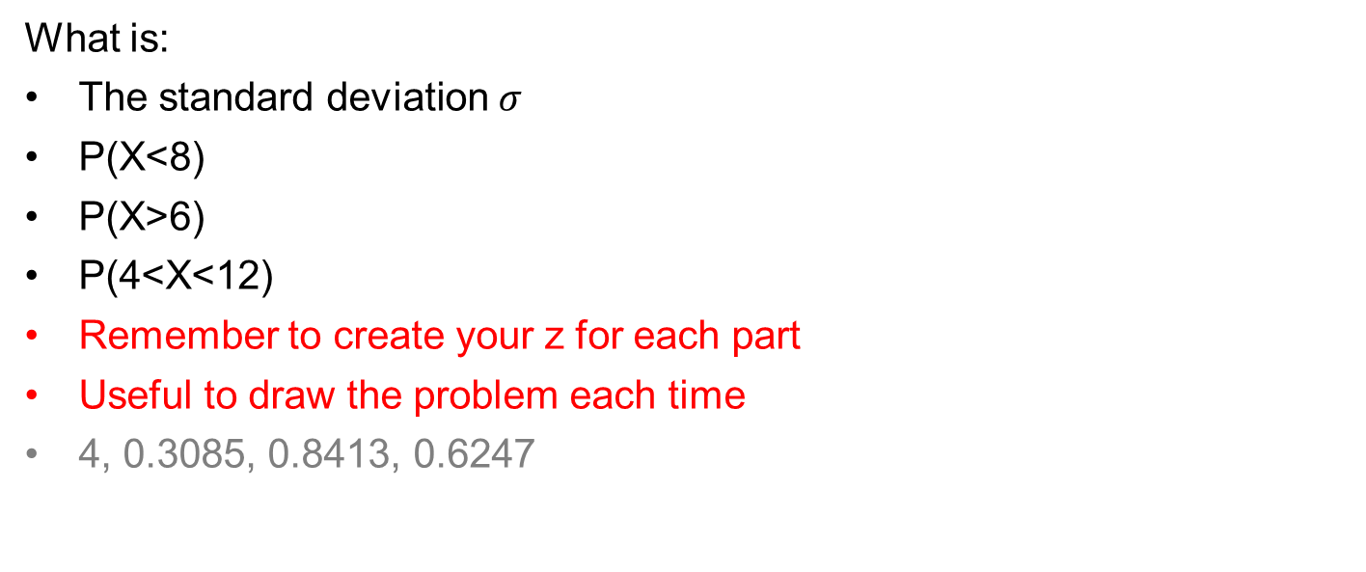
problem
X has a normal distribution with mean 10 and variance 16
What is:
The standard deviation $σ$
P(X<8)
P(X>6)
P(4<X<12)
Remember to create your z for each part
Useful to draw the problem each time
4, 0.3085, 0.8413, 0.6247

Slide 57
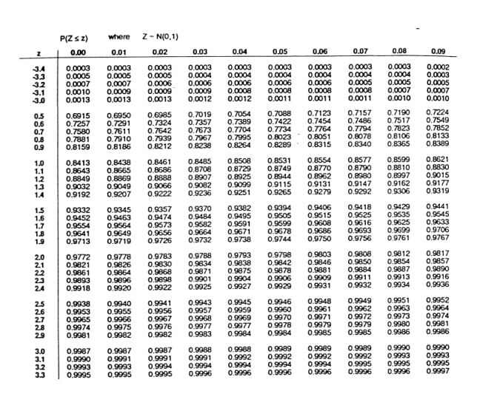

Slide 58
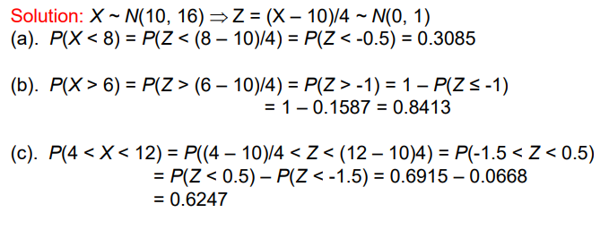
solution

Slide 59

Typical normal distribution question

Slide 60


Solution

Slide 61

Workshop question #15 – working backwards

Slide 62
Limitations of normal distributions
Using this basic normal distribution assumes that you know the mean and variance of the whole population; this can be difficult to know as…
Is all data normally distributed?
What information do you need to calculate the mean and variance of a large population?
How much time and $$$$ do you have?
Think of an organisation that specialises in collecting and using enormous amounts of data.

Slide 63
The world is not always normal
The trouble with normal distributions is that it sounds so NORMAL
It is nice to think that “all things” has some beautiful inherent symmetry and that if you have enough data it is OK to assume NORMALITY
WRONG
Data is often skewed (not symmetrical) or is symmetrical but not normally distributed.
MJ made the mistake of assuming normality when she had n=500 bits of data. When she graphed the data…….it didn’t even look bell shaped, let alone symmetrical and when tested for normality it wasn’t. A week wasted…
So where do we use normal distributions? NEXT WEEK.

Slide 64
Homework Bernoulli and Binomial
The probability of Yasir scoring a goal at football is 27%.
What sort of variable is 27%?
What is the probability he will miss the goal?
If Yasir has 9 shots at goal how many goals would he expect to score?
What is the probability he will score
4 of the next 9 shots
None of the next 9 shots
Less than 1 shot
1 of the next 9 shots
At least 1 of the next 9 shots
At least 2 of the next 9 shots
No more than 8 of the next 9 shots

Slide 65
Answers Bernoulli and Binomial

Slide 66
Homework - poisson and binomial
On average there are 6 accidents per week on Manning Rd. Assuming a Poisson Distribution determine the probability that in a week there are:
No accidents
Some accidents
5 accidents
More than 3 accidents but less than 6
5 accidents per week in 6 of the next 10 weeks
What is the average number of accidents per day?
Still assuming a Poisson Distribution determine the probability that on a given day there are:
No accidents
Some accidents
5 accidents
More than 3 accidents but less than 6
No accidents in 6 of the next 10 days

Slide 67
Answers Poisson and binomial

Slide 68

Homework Normal distributions
Assuming a normal distribution, $μ=10, σ=3$ determine
$P\left(X<10\right)$
$P\left(X>10\right)$
$P\left(X=10\right)$
$P\left(X<4.5\right)$
$P\left(X>4.5\right)$
$P\left(X>11\right)$
$P\left(X>20\right)$
$P\left(4.5<X<10\right)$
$P\left(10<X<13\right)$
$a$ such that $P\left(X<a\right)=0.33$
$b$ such that $P\left(X>b\right)=0.33$
$P\left(a<X<b\right)$

